Slide 1
Investments AI Circle
FOLLOW-UP
30 June 2025

Slide 2

Index
1) Survey
2) Recent updates in AI
3) Use cases
3.1) Model Context Protocol (MCP)
3.2) How Anthropic Built a Multi-Agent Research System
3.3) How to build Custom GPTs & Use Cases
4) Takeaways

Slide 3
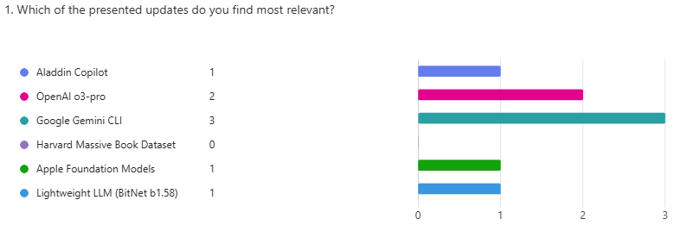
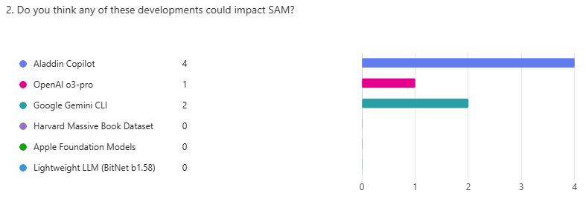
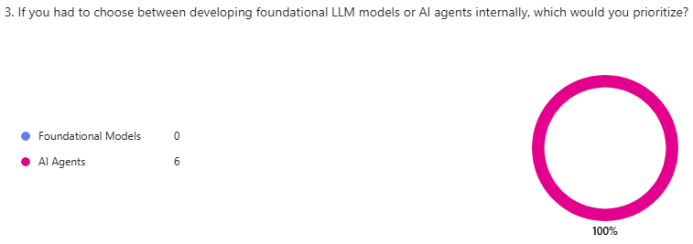
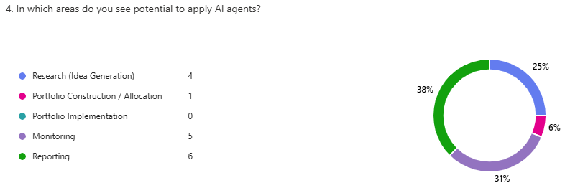
1) Survey (I)

Slide 4
1) Survey (II)
Can you think of any idea, project, or exploratory path that we could evaluate or develop within SAM based on these advances?
Answers
I guess the most benefits will com for researchers, as they can access and process many information with simple prompts.
"Equity Research AI Agent" using "OpenAI o3-pro“.
I believe we should consider expanding our exploratory path beyond LLM (or similar) transformer-based models, particularly for tasks like forecasting and decision-making (e.g., portfolio construction)
Would you like to present any other AI news, your idea or comment during the meeting?
Answers
No answers.

Slide 5
2) Recent updates in AI
Recent AI breakthroughs span enterprise integration, open-source developer tools, advanced reasoning models, and ethical training data—highlighting both innovation and adoption at scale.
Aladdin
AI models
Foundational Models & Quantization
1) Aladdin Copilot
From July 18, users can query portfolio analytics and summarize research notes using natural language across all Aladdin apps.
Marks the first native integration of generative AI in Aladdin—making advanced insights accessible to any user.
2) o3-pro: OpenAI’s Reasoning-First Powerhouse
Excels in complex tasks like math, science, and code; outperforms previous OpenAI models.
High latency and cost make it ideal only for tasks requiring deep multi-step reasoning.
5) Apple Updates Its Foundation Models (AFM)
AFM-on-device and AFM-server enable vision-language tasks with efficient deployment.
Focus on edge AI integration could boost Apple’s position in on-device intelligence.
3) Google Launches Gemini CLI
Brings conversational AI to the terminal for code, docs, and file handling.
Open-source and extensible—positions Gemini as a core interface for developers.
6) BitNet b1.58: Lightweight LLM with Strong Performance
Uses ultra-low precision (1.58-bit) weights to run fast and efficiently with strong results.
Matches or beats many small models—ideal for low-resource environments.
Datasets
4) Harvard Releases Massive Book Dataset to Train AI
Nearly 1M public domain books released for LLM training (242B tokens, 254 languages).
Offers a vast, legally safe alternative to copyrighted content for AI training.

Slide 6
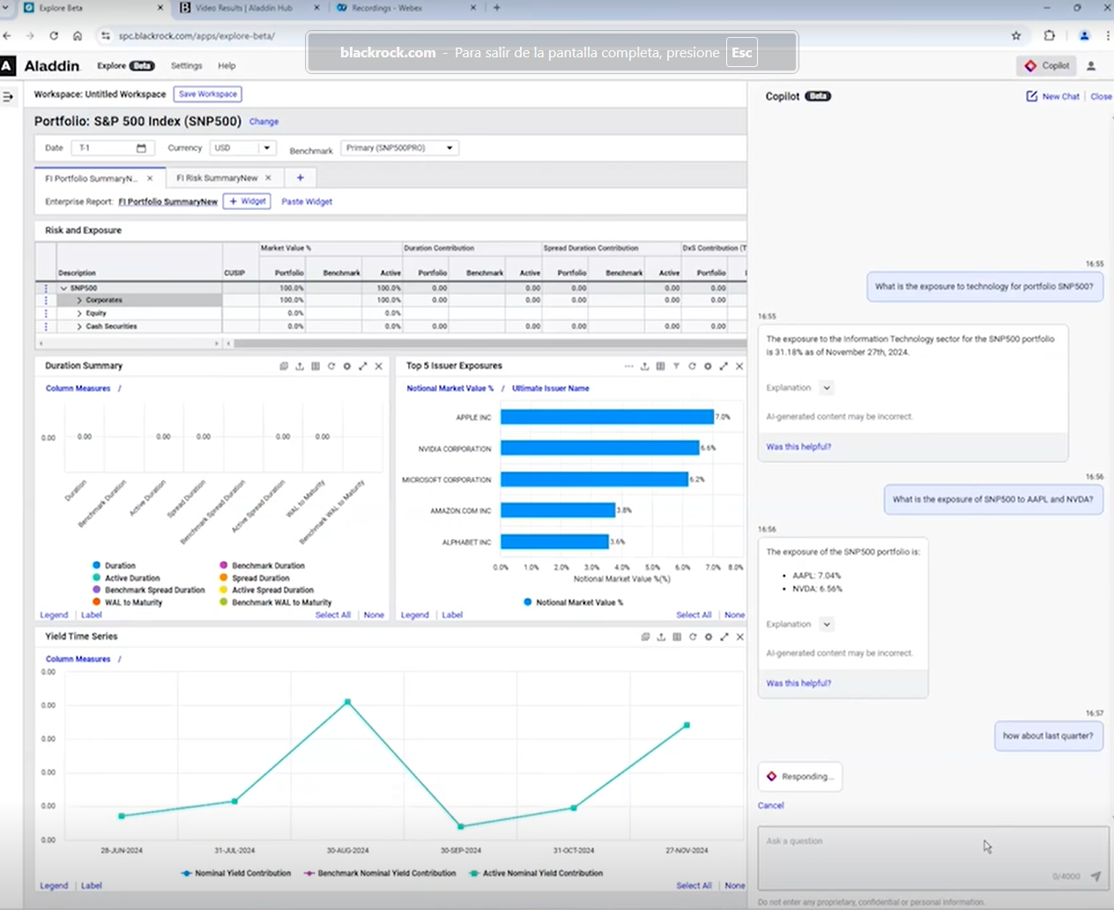
2.1) Aladdin Copilot
BlackRock launches AI-powered assistants in Aladdin, enabling natural language queries across portfolio data and investment research. The update goes live on July 18.
Portfolio Agent: Users can ask questions on exposures, risk, and performance using over 100 analytics fields—now accessible via chat across all Aladdin apps.
Research Agent: Summarizes and analyzes research notes, with keyword extraction and source linking built in.
Why it matters: This is the first native integration of generative AI in Aladdin. It brings powerful analytics and research workflows to any user, just by asking.
Links:
Video Results | Aladdin Hub

Slide 7
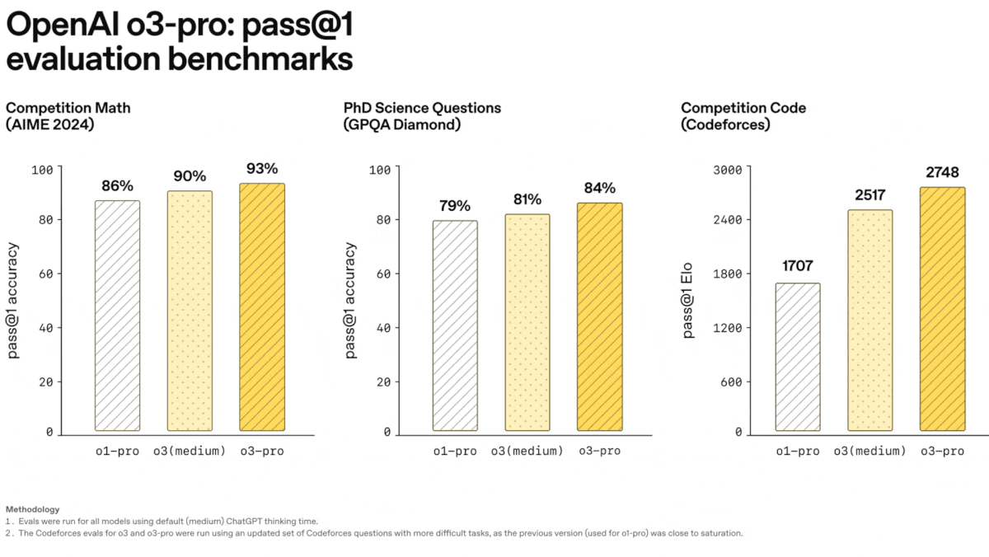
2.2) o3-pro: OpenAI’s Reasoning-First Powerhouse (Available in SAM)
OpenAI released o3-pro, its most advanced model for logic-heavy tasks like math, coding, and science.
Capabilities: Processes up to 200K input tokens and delivers highly accurate results on AIME, GPQA Diamond, and Codeforces benchmarks.
Performance: Outperforms o3 and o1-pro in nearly all evaluated tasks, especially multi-step reasoning challenges.
Tradeoff: Extremely slow (129 seconds to first token) and costly ($20–$80 per million tokens).
Links:
Model Release Notes | OpenAI Help Center
ChatGPT Enterprise - Models & Limits | OpenAI Help Center
Why it matters: o3-pro pushes the frontier of reasoning LLMs, ideal for specialized scientific use cases. Developers now face a tradeoff between speed and depth of thought, calibrating model selection to task complexity.

Slide 8
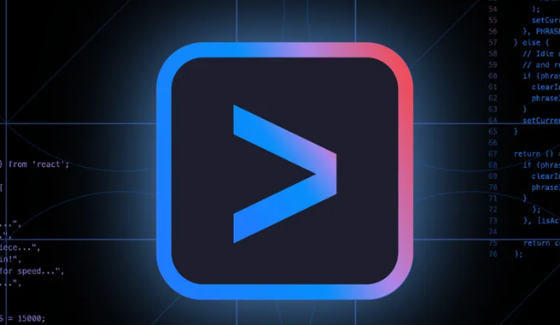
2.3) Google Launches Gemini CLI: Open-Source AI Agent for Developers
Google has released Gemini CLI, a new open-source command-line AI agent designed to assist developers with everyday tasks in natural language.
Purpose: Brings conversational AI to the developer terminal — letting users run commands, read documentation, write code, and interact with files using natural language.
Technology: Powered by Gemini 1.5 Pro via the Vertex AI SDK, with plans to support other models in the future. The CLI agent runs locally but calls model APIs via the cloud.
Open Source: Available on GitHub under the Apache 2.0 license. Google encourages contributions and extensions.
Links:
https://blog.google/technology/developers/introducing-gemini-cli-open-source-ai-agent/
Why it matters: Highlights a growing trend: embedding conversational agents into developer workflows. By open-sourcing the tool, Google is positioning Gemini as a key interface between developers and AI.

Slide 9

2.4) Harvard Releases Massive Book Dataset to Train AI
Harvard University has publicly released Institutional Books 1.0, a dataset of nearly one million digitized books, to support the development of large AI models.
Scale: 394 million scanned pages and 242 billion tokens, covering 254 languages and texts dating back to the 15th century.
Content: Public domain material from literature, law, agriculture, and philosophy—avoiding modern copyright issues.
Availability: Free to download on Hugging Face; backed financially by Microsoft and OpenAI.
Links:
Libraries open their stacks up as training data for artificial intelligence platforms | AP News
Why it matters: Amid growing legal scrutiny over the use of copyrighted data, Harvard’s release offers a vast, ethical alternative for training LLMs—potentially reshaping how AI systems are built and scaled.

Slide 10
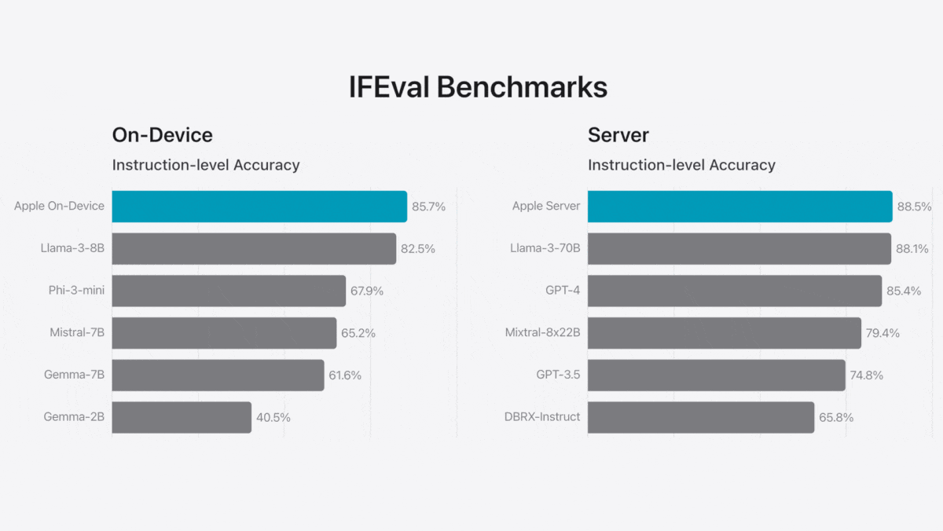
2.5) Apple Updates Its Foundation Models
Apple expands its AI capabilities through Apple Foundation Models (AFM), enhancing vision-language performance and providing developer tools.
Models: AFM-on-device (3B + 300M parameters) and AFM-server (custom MoE + 1B vision encoder).
Features: Vision, tool use, multi-language support, quantized models for efficiency, LoRA adapters for task-specific tuning.
Deployment: AFM-on-device available via developer framework; AFM-server is internal use only.
Performance: Strong in image understanding and non-U.S. English tasks; mixed results vs. competitors in general benchmarks.
Links:
Updates to Apple's On-Device and Server Foundation Language Models - Apple Machine Learning Research
Foundation Models | Apple Developer Documentation
[1712.05877] Quantization and Training of Neural Networks for Efficient Integer-Arithmetic-Only Inference
Why it matters: Apple is catching up by focusing on edge efficiency and developer integration. Its hardware-software ecosystem could give it a competitive edge in on-device AI adoption.

Slide 11
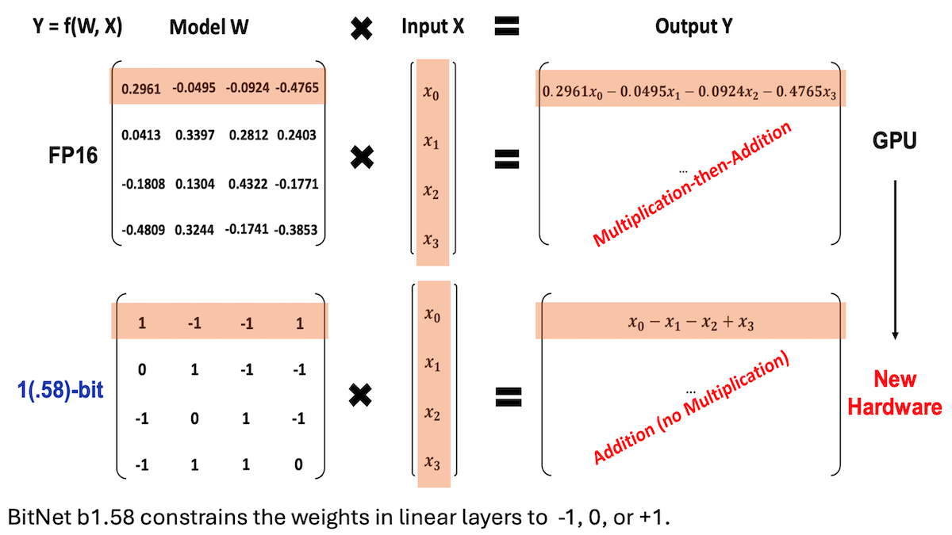
2.6) BitNet b1.58: Lightweight LLM with Strong Performance
Researchers from Microsoft, the University of Chinese Academy of Sciences, and Tsinghua University introduced a compact LLM with highly compressed weights, retaining competitive performance.
Architecture: Transformer with 2B parameters using ternary weights (-1, 0, +1), requiring only ~1.58 bits per parameter.
Method: Hybrid quantized training regime, multi-phase learning and decay schedules, optimized for reasoning and instruction following.
Results: BitNet outperformed most small models in accuracy (54.19%) while requiring just 0.4GB memory and generating 2x faster output than Qwen2.5 1.5B.
Why it matters: BitNet demonstrates that with thoughtful design and training, low-precision models can rival full-size competitors—enabling powerful LLMs to run efficiently on low-resource hardware.
Links:
[2504.12285] BitNet b1.58 2B4T Technical Report

Slide 12
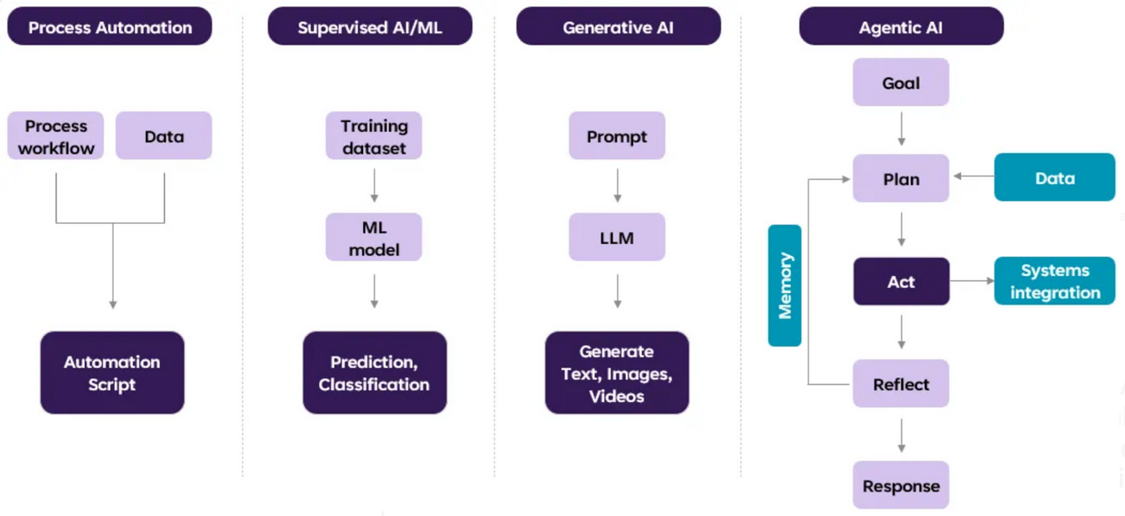
3.1) Model Context Protocol (MCP) - Overview
Who would use the MCP protocol?
Developers working with AI models or AI Agents —automated systems that can perform tasks like writing reports, checking data, or making recommendations.
What is MCP used for?
To easily connect an AI model to tools and data sources in order to build AI Agents.
MCP acts like a universal adapter, instead of building a custom connection for every tool, MCP allows the model to connect in a standardized, fast, and secure way.

Slide 13
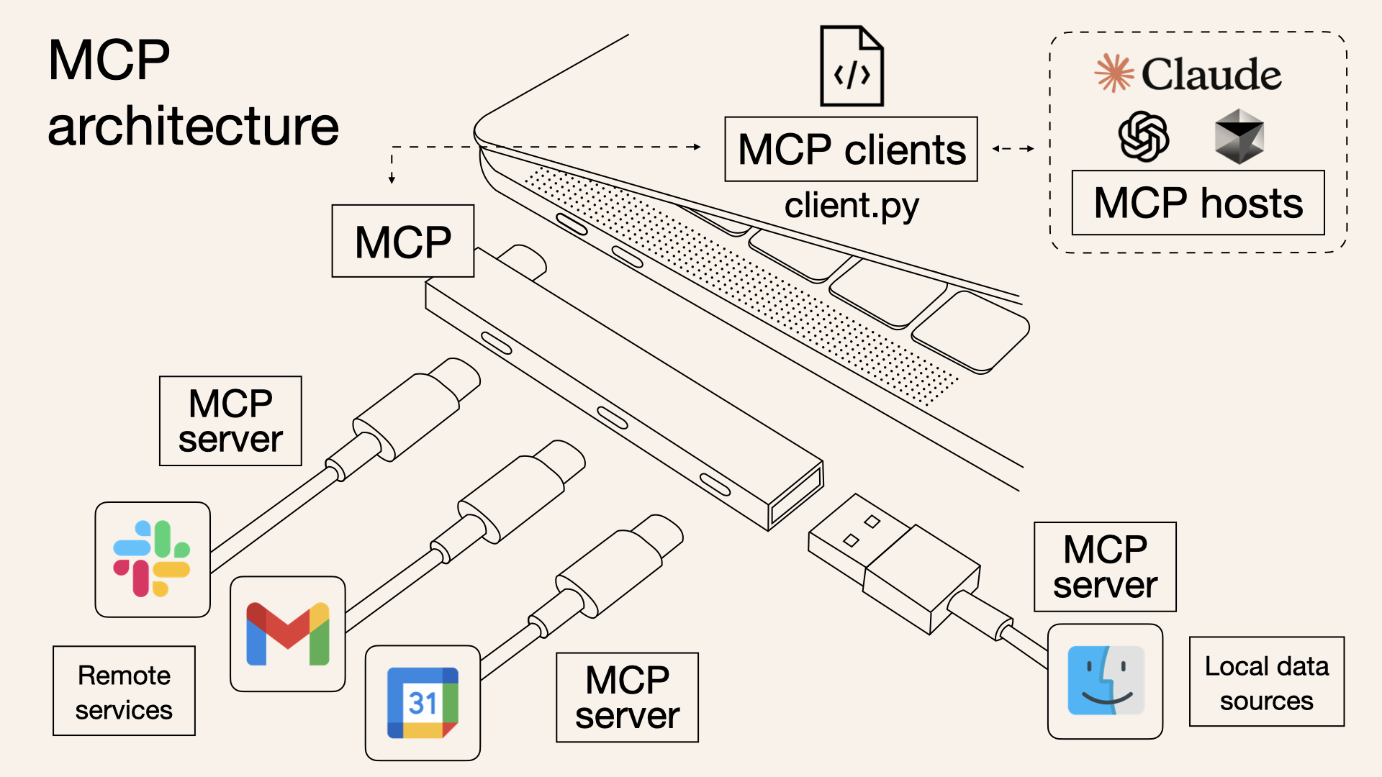
3.1) Model Context Protocol (MCP) – Technical Overview
Purpose: Simplify and standardize how AI models connect with external systems, reducing the need for bespoke integrations for each use case.
Definition: MCP is an open standard developed by Anthropic in 2024 that allows language models (LLMs) to interact securely and consistently with external tools, data sources, and services.
Analogy: It acts like a “USB-C for AI”, enabling universal plug-and-play connections between models and systems—no need for custom integrations.
Architecture:
MCP Host: The application running the AI model (e.g., Claude Desktop).
MCP Client: Connects the host to MCP servers.
MCP Server: Exposes data, tools, or prompts that the model can access.
ACP is an alternative to MCP, developed by OpenAI in 2024. While MCP focuses on connecting AI models to external tools and data, ACP is designed to enable structured communication between multiple AI agents—and between agents and tools.

Slide 14
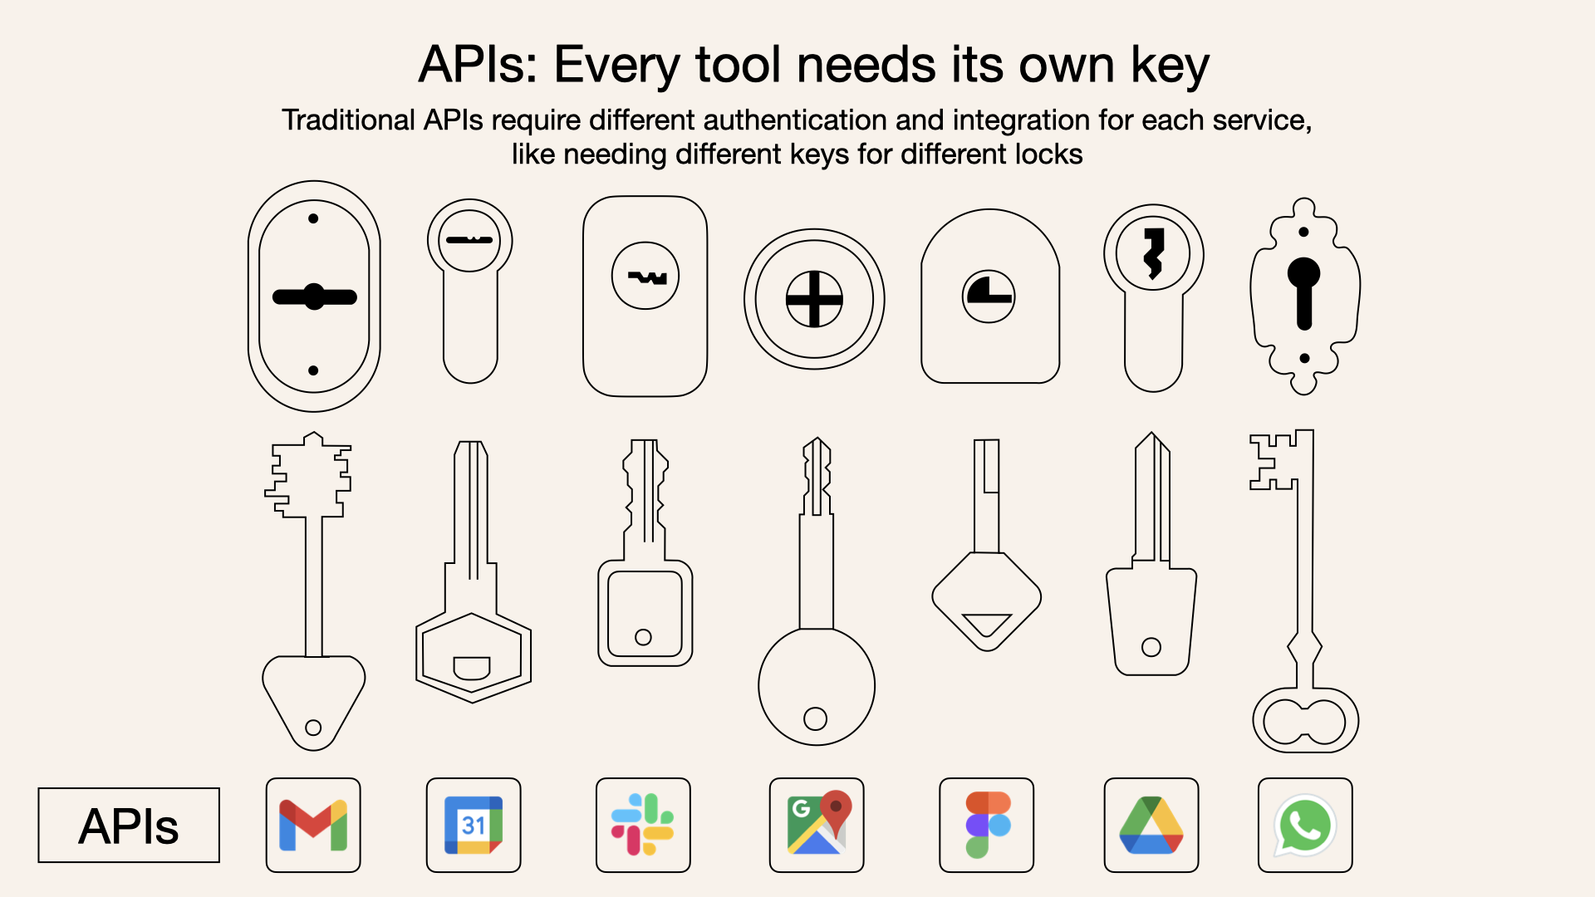
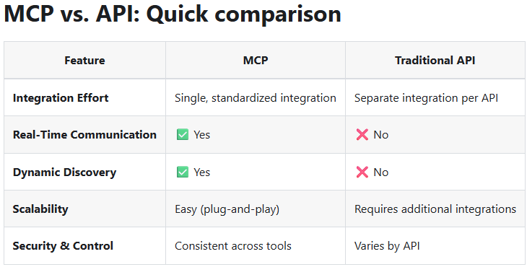
3.1) Model Context Protocol (MCP) - Why is MCP Relevant Now?
MCP Advantages:
Enables dynamic discovery of available tools and services.
Facilitates real-time, two-way communication between models and external systems.
Reduces complexity and integration costs.
Growing Adoption:
Companies like OpenAI, Google DeepMind, and Microsoft are exploring or supporting MCP-like approaches—signaling a broader move toward standardization.
Current Challenges:
Models need custom integration for each tool or data source.
Difficulties in maintaining coherent context across systems.
Links:
https://norahsakal.com/blog/mcp-vs-api-model-context-protocol-explained/
https://apidog.com/es/blog/mcp-servers-explained-2/

Slide 15
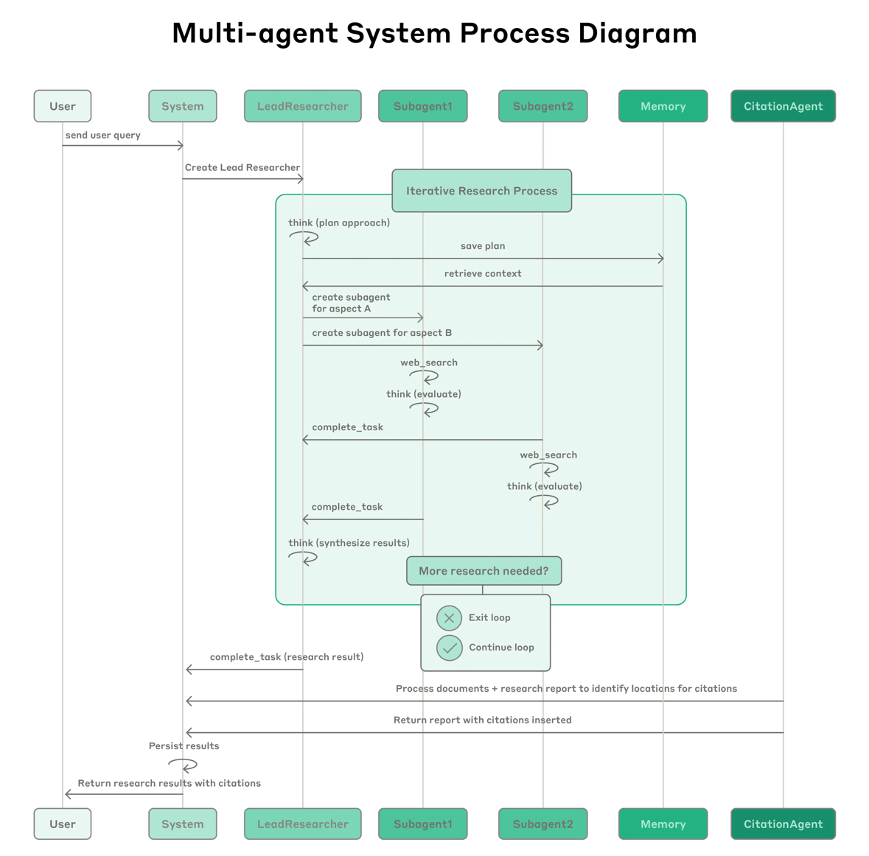
3.2) How Anthropic Built a Multi-Agent Research System
Purpose
Claude's new Research feature uses multiple AI agents to solve complex tasks more efficiently—such as exploring the web, analyzing documents, and summarizing insights.
How It Works
A Lead Agent plans the research process.
It creates Subagents that search different topics in parallel.
Results are combined into a high-quality, cited answer.
Why Multi-Agent?
Handles open-ended tasks better than single models.
Explores more directions in less time.
Performs significantly better (+90%) on complex queries than single-agent setups.

Slide 16
3.2) How Anthropic Built a Multi-Agent Research System - Key Learnings for Multi-Agent AI Systems & Proposed use cases
Benefits
Enables scalable, autonomous reasoning across large information spaces.
Allows dynamic workflows—adapting to new information on the fly.
Matches how human teams research: parallel, iterative, and flexible.
Challenges
Multi-agent systems use ~15× more tokens than simple chats.
Require careful prompt design, tool selection, and coordination.
Debugging is harder due to unpredictable agent behavior.
Engineering Best Practices
Design agents that delegate and think step-by-step.
Use parallel tool calls and task-specific subagents.
Combine human testing with LLM-based evaluation to ensure quality.
USE CASES
Company intelligence
Identifying all board members of companies in the S&P 500 Information Technology sector through task decomposition.
Technical troubleshooting
Helping resolve complex technical bugs more efficiently.
Research acceleration
Saving users hours or days by revealing research connections not found through traditional methods.
Strategic synthesis
Using custom AI to process macroeconomic and geopolitical data and create high-level narrative frameworks—similar to what expert economists do.

Slide 17

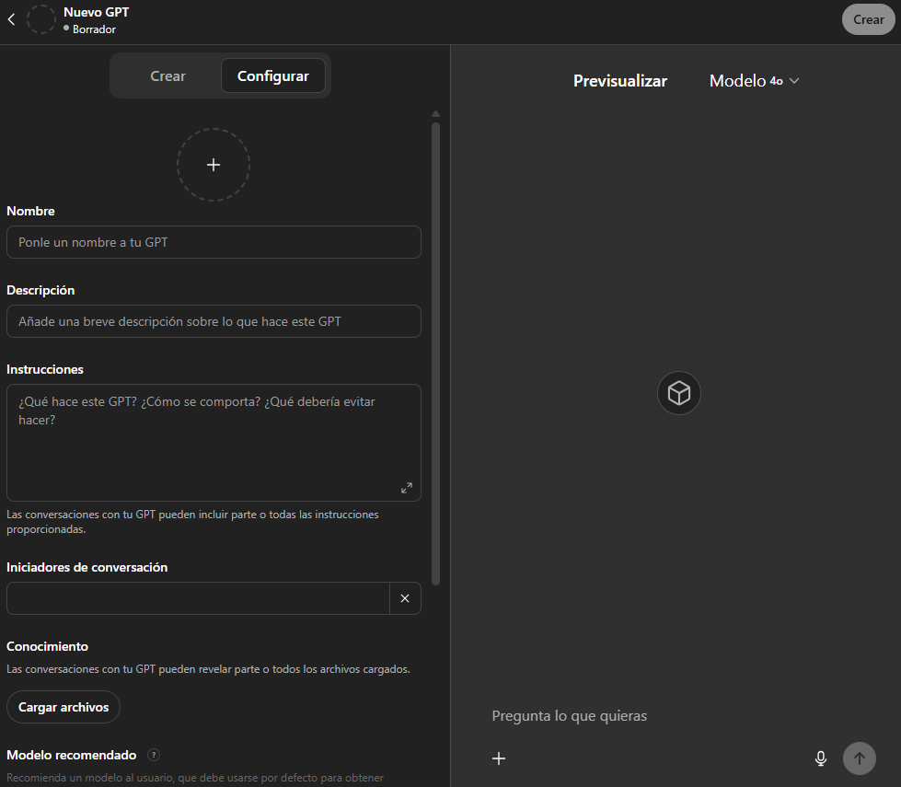

3.3) How to build Custom GPTs & Use Cases
Tariff-Man
Provides structured analysis on trade policy impacts —such as tariffs— on macro variables and markets, similar in scope to the Equity Sector & Factor Analyst but not sector-specific
Equity Sector & Factor Analyst
Analyzes the impact of trade policies (e.g., tariffs) on growth, inflation, and markets, with a focus on equity sectors and factors exposure
FX Strategist
Develops foreign exchange strategies based on macroeconomic and fundamental analysis
Behavioral Bias Analysis
Identifies behavioral biases in monthly Asset Allocation decisions by analyzing historical data, performance, and narratives
GPT Generator
Assists in creating custom GPTs by guiding users through the definition of objectives, key features, interaction style, and usage constraints

Slide 18
4) Takeaways (I)
General discussions
Aladdin Copilot Phase 2 (Mid-July Launch):
Prompt-based assistant will support queries across various tools, e.g., attribution analysis, summarizing research.
Distribute upcoming Aladdin Copilot Phase 2 user guide and usage instructions.
Follow up on formative materials or onboarding documentation for new Aladdin Copilot users.
Strong interest in applying AI for reporting and research tasks; low interest in foundational model theory noted.
Discussion about internal development of tailored foundational models for Santander based on internal data.
JP Morgan and BlackRock reached 98.5% accuracy using supervised learning on top of LLMs, with human-in-the-loop mechanisms.
MCPs are early-stage, with limited documentation but high potential for scalable AI workflows/agents.

Slide 19
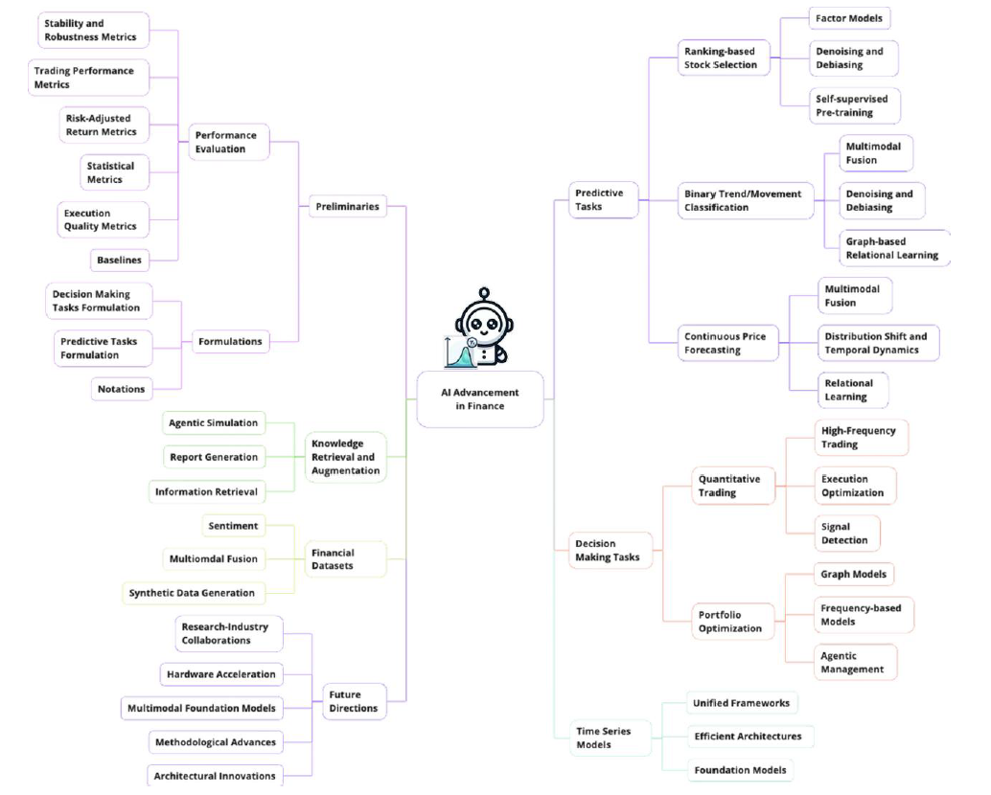
4) Takeaways (II)
AI Use Cases from Participants
Santander Foundational Models (Iñaki Munarriz):
Proposal to explore building proprietary foundational models (LLMs or smaller models) trained on Santander-specific data.
Goal: Increase relevance, accuracy, and contextual awareness in internal use cases such as investment research, reporting, and decision-making.
Potential benefits include enhanced performance, faster inference (especially with quantized models), and reduced dependency on external platforms.
JP Morgan and BlackRock: Supervised Learning for High-Accuracy AI Agents (Luiz Felix & Guido Chagas):
Both institutions integrated supervised learning layers on top of general-purpose LLMs to boost domain-specific accuracy.
Achieved 98.5% accuracy by iteratively fine-tuning model outputs using internal data and human feedback.
A human-in-the-loop system is triggered when the model's confidence is low or outputs are ambiguous.
Ensures safe deployment in client-facing environments by mitigating hallucinations or factual errors.
Highlights importance of model reliability before enabling autonomous or externally exposed AI agents.

Slide 20
Gracias
Thank you

